Slide 1
Second Life IT & Recycle
Dominik Galgus (C00257383)
Information Technology Management

Slide 2
Project Research and Preparation
Before starting this project, a few ideas were considered:
1. News application with a "For You" Page to filter news stories
2.A Fake News Detection system = Machine learning to analyse real and fake news titles and content to determine which one is which.
Final Idea that was agreed upon was this project which is a service designed to reduce wastage + increase reusability in schools and colleges.

Slide 3
Introduction To this Project (Second Life IT & Recycle)
The goal of this project was:
1.To design a service and a website to allow people from schools/colleges to put up listings on the website. For items that the schools and colleges no longer need
2. Allow private individuals to claim those no longer needed items.

Slide 4
Project Dimensions
I will be talking about this project mostly in terms of 3 different dimensions/aspects which are the:
Business = Business aspects relating to project
Technical = Technical Aspects and Technical Issues Relating to project
Ethical = Ethical Impacts and any Ethical problems related to the project

Slide 5
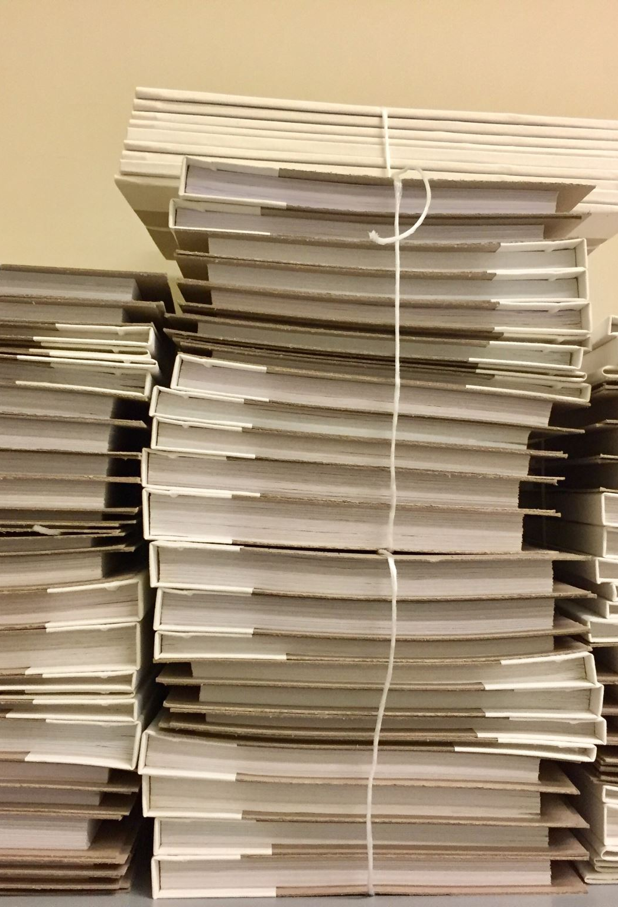
Research
Research was done inside the college to find out how the SETU Carlow currently disposes of equipment
Research conducted = on the competitors of the service like Adverts, Ebay and Facebook Marketplace.
One thing that helped me during this project was a paper on Recycling and Re-Use Of mobile phones:
1.Which helped identify "Pain points" when it comes to acquiring and Re-using technology
2.Gave ideas on how to tackle these issues effectively
3.It helped inform me on how organizations of both large and small size get rid of equipment currently (ie through contractors or other agreements)

Slide 6
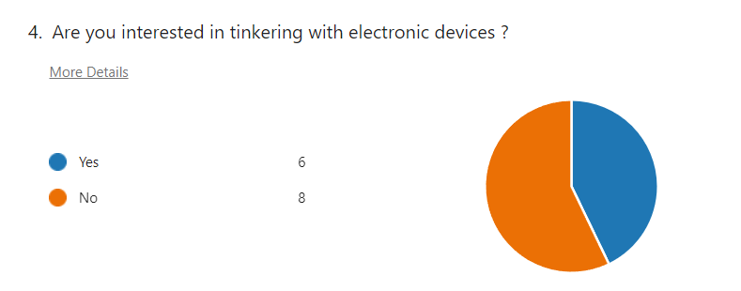
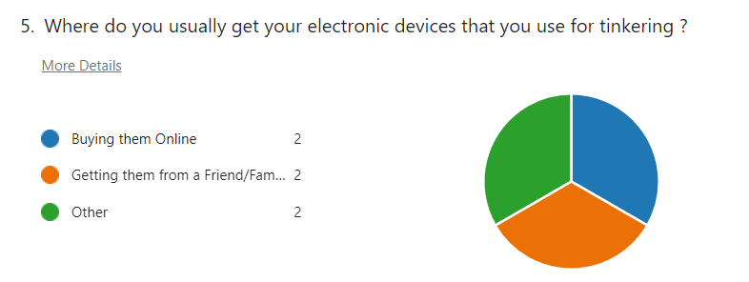
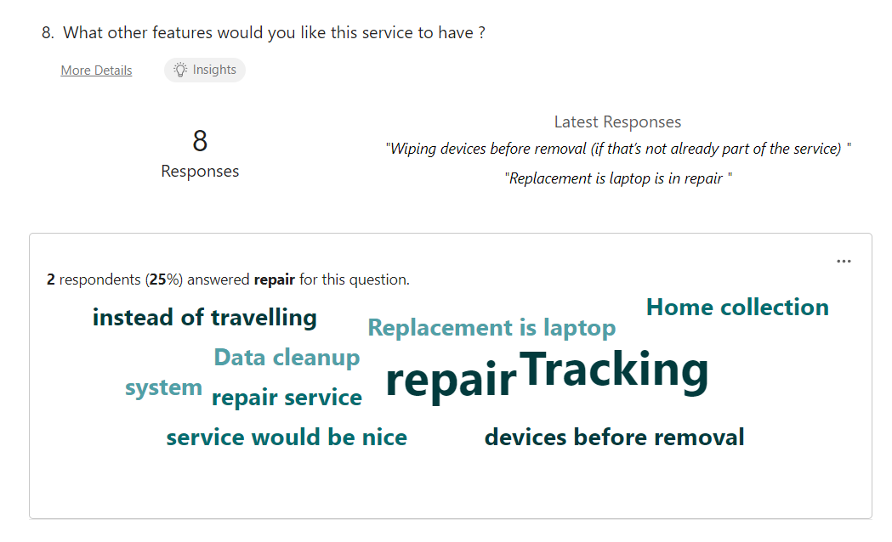
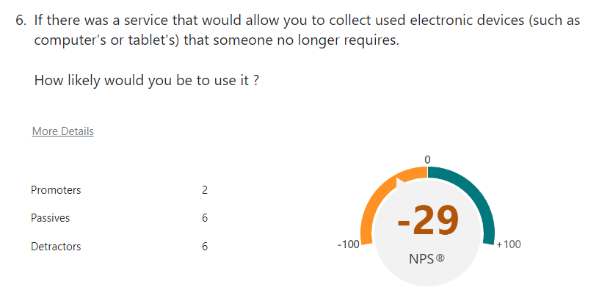
Survey
Lastly a survey was conducted to see:
1.How much interest there would be in a service,
2.where do people get their equipment from right now
3.What features they would like implemented into the service

Slide 7
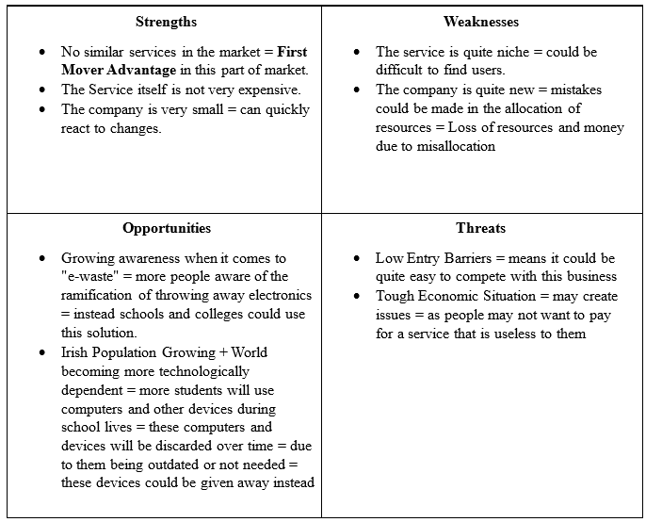
Business Aspect
When it comes to the business aspect a SWOT analysis was conducted on the service itself:

Slide 8
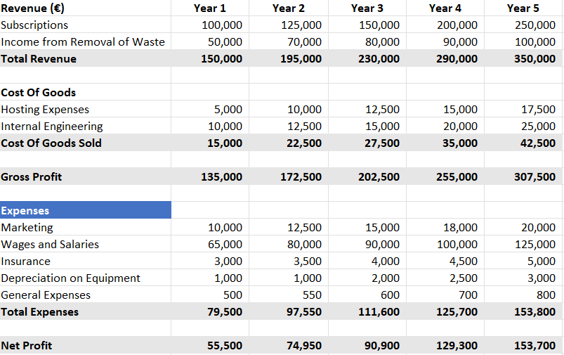
5 Year Plan
Another part that was made out was a 5-year plan
Involves all the expenses and income for the business
The Gross Profit and Net Profit Figures are also included

Slide 9
Business Requirements
Were also extrapolated like
Is the solution:
Cost Effective ?
Scalable ?
Accurate and Reliable ?
Among other Requirements

Slide 10
Laws and Legislation
GDPR (The General Data Protection Regulation)
Important to businesses and different organisation
Gives Individuals the rights to ask for a copy of the data, deletion or redaction
In order to prevent issues:
A system would need to be developed to “erase personal data in specific situations or restrict their processing” (Data & IT Law,2024).
In Order to make information requests easier use of personal data should be minimized
Waste Management Act 1996
Waste disposal and recovery activities in Ireland require authorisation” (EPA,2024)
In order to get rid of Electronic Waste In Ireland you need a permit so a permit would need to be acquired

Slide 11
Technical Aspects
Initially there was 3 different solutions that were devised for this project which was a:
Website = Which schools and colleges could use to dispose of equipment and have it be collected by the private individuals
NFC Tags = Would be stuck on equipment that would need to be collected
Mobile Application = Where the equipment would be collected and subsequently upgraded and then given back
The website was the solution picked in the end and this is what become "Second Life IT & Recycle"

Slide 12
Evaluation Section
Each of the solutions given before were then evaluated by some of the requirments:

Slide 13
Technologies being used
HTML (Hypertext Markup Langauge)
To build the overall structure of the website
PHP (Hypertext Processor)
To help execute commands on the webpage and database
CSS (Cascading Style Sheets)
Dictates how the website looks
SQL (Structured Query Langauge)
Used to retrieve information from the database and select display specific records

Slide 14
PRoject work
A database was created for this project that contains a:
School Table
Contains data about the schools/colleges in the database

Slide 15
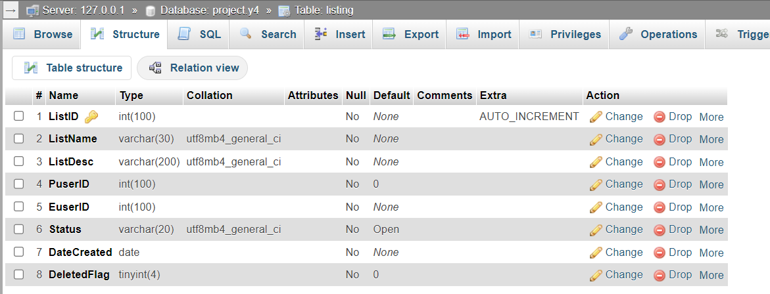
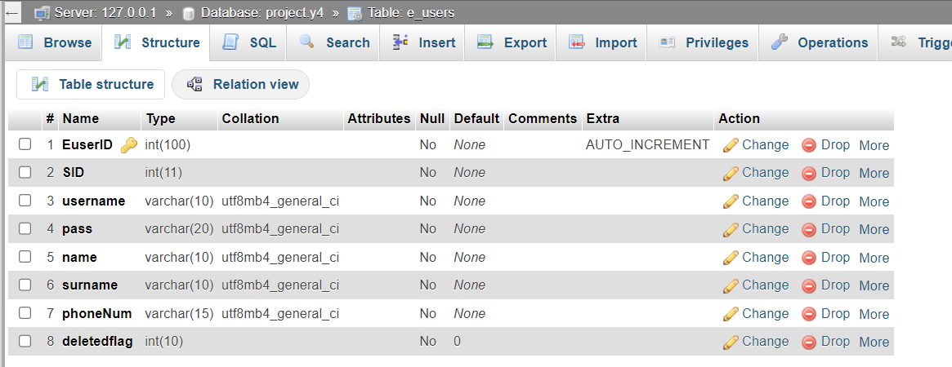
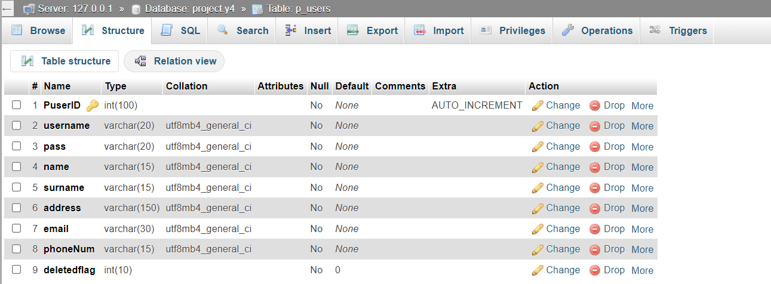
Listings Table
Data about listings
E_Users Table
Data about educational users from schools/colleges
P_Users Table
Data about private users who are private individuals

Slide 16
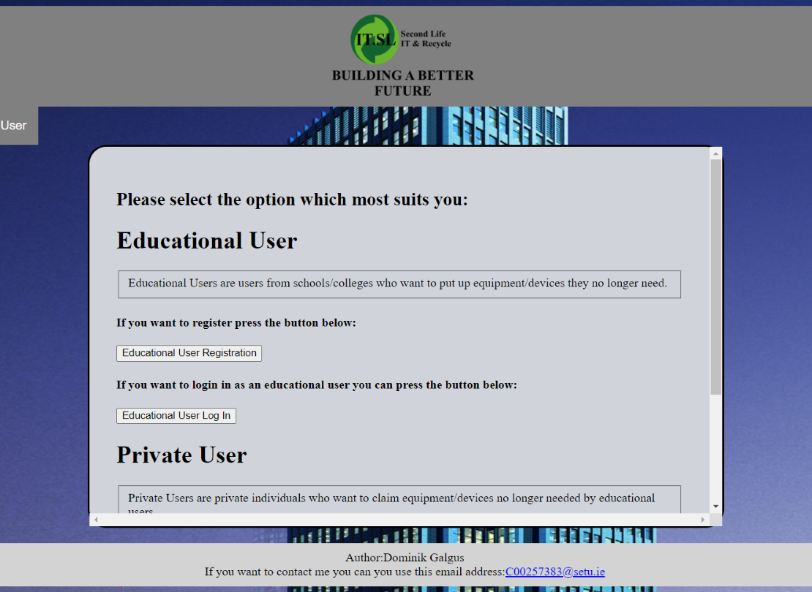
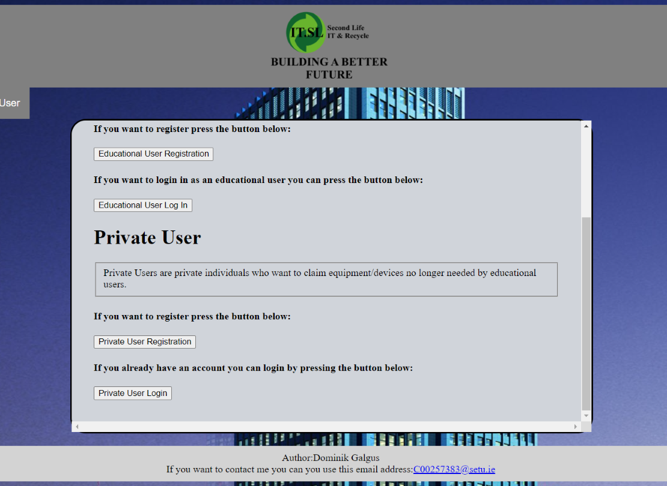
Screens
Start Up Screen
This screen is the screen that will be presented to the user when they first start up the website
Allow them to pick from a variety of options like Registering/Logging in as a private or educational user.

Slide 17
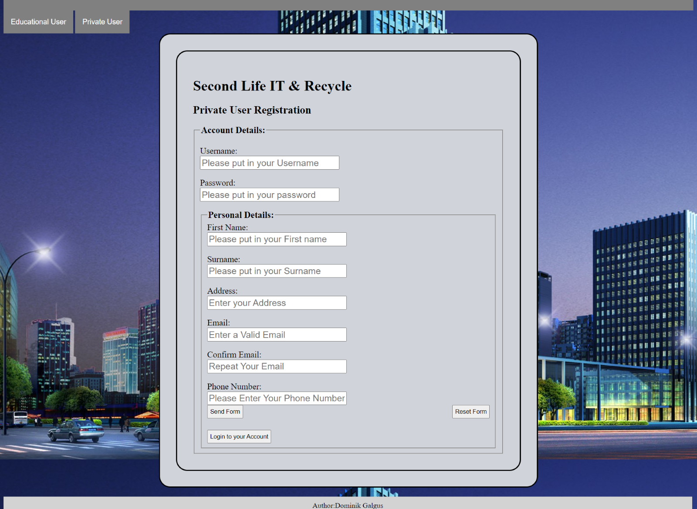
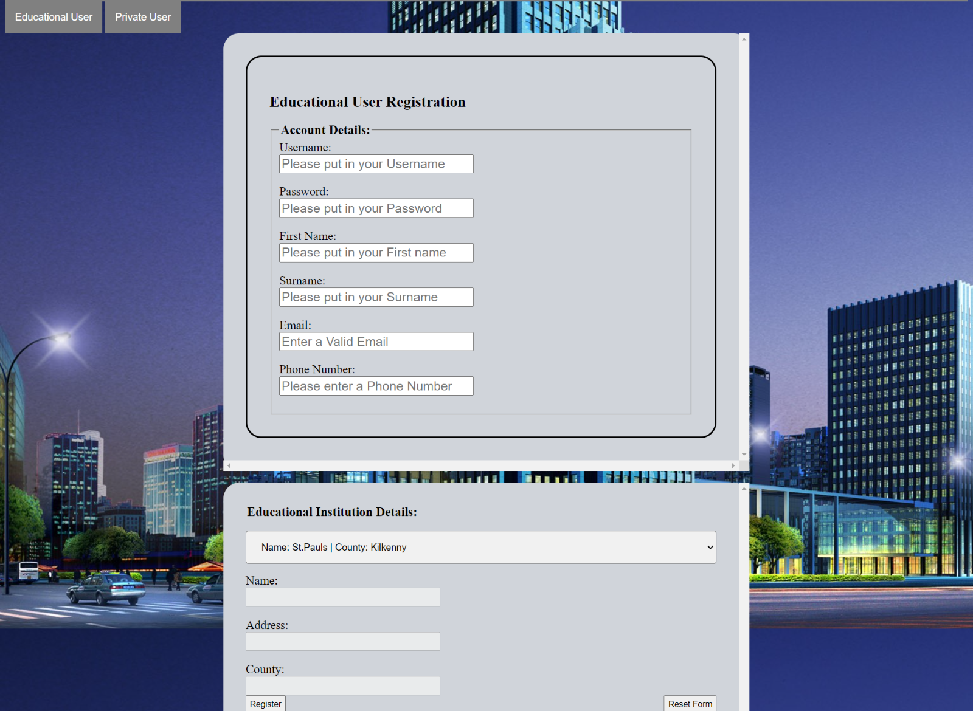
Registration Screens
Both the Educational and Private User side have registration screens which allow them to register as their prospective users.
Both different from each other.

Slide 18
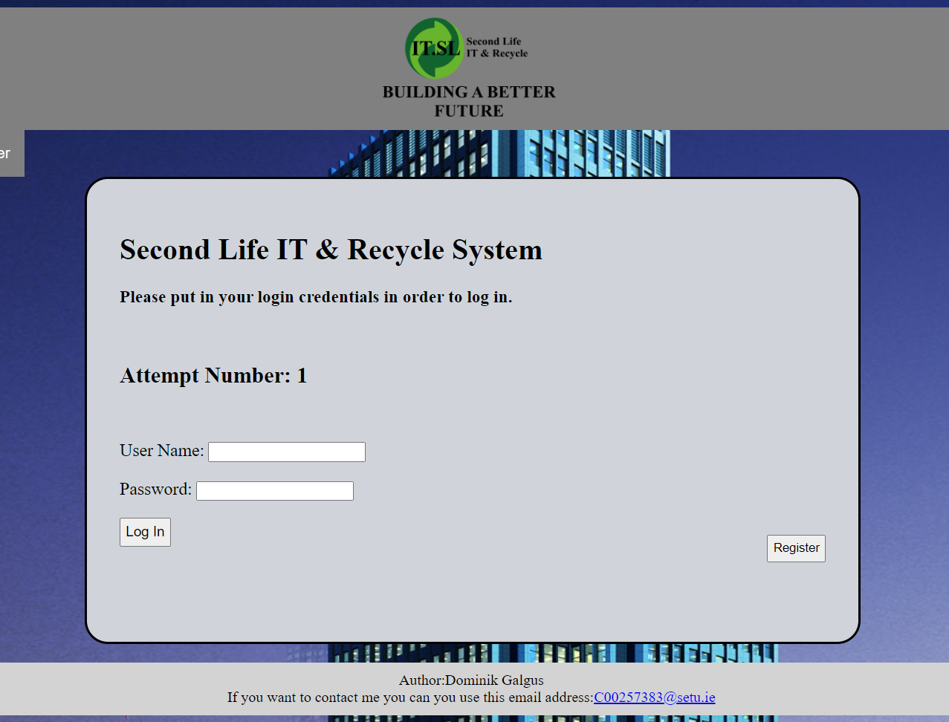
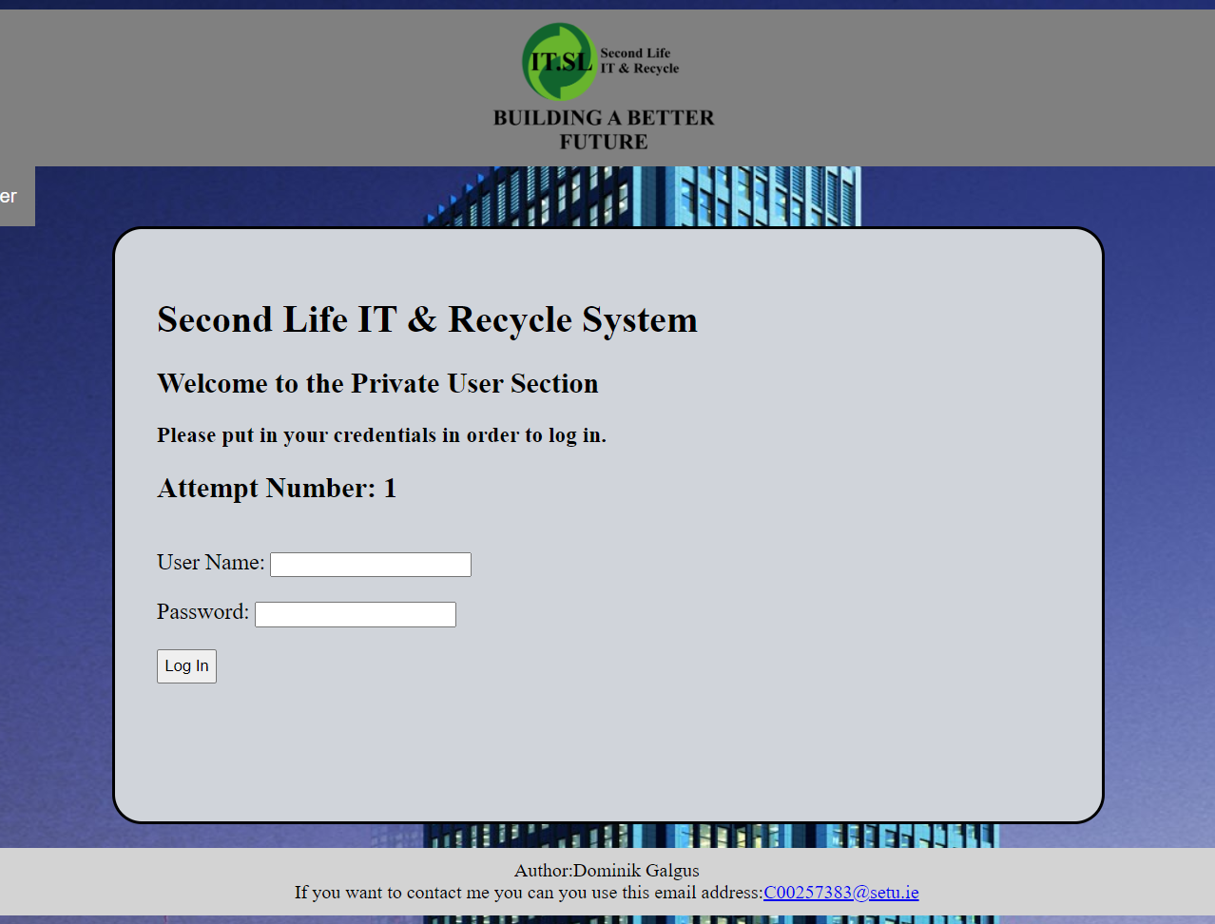
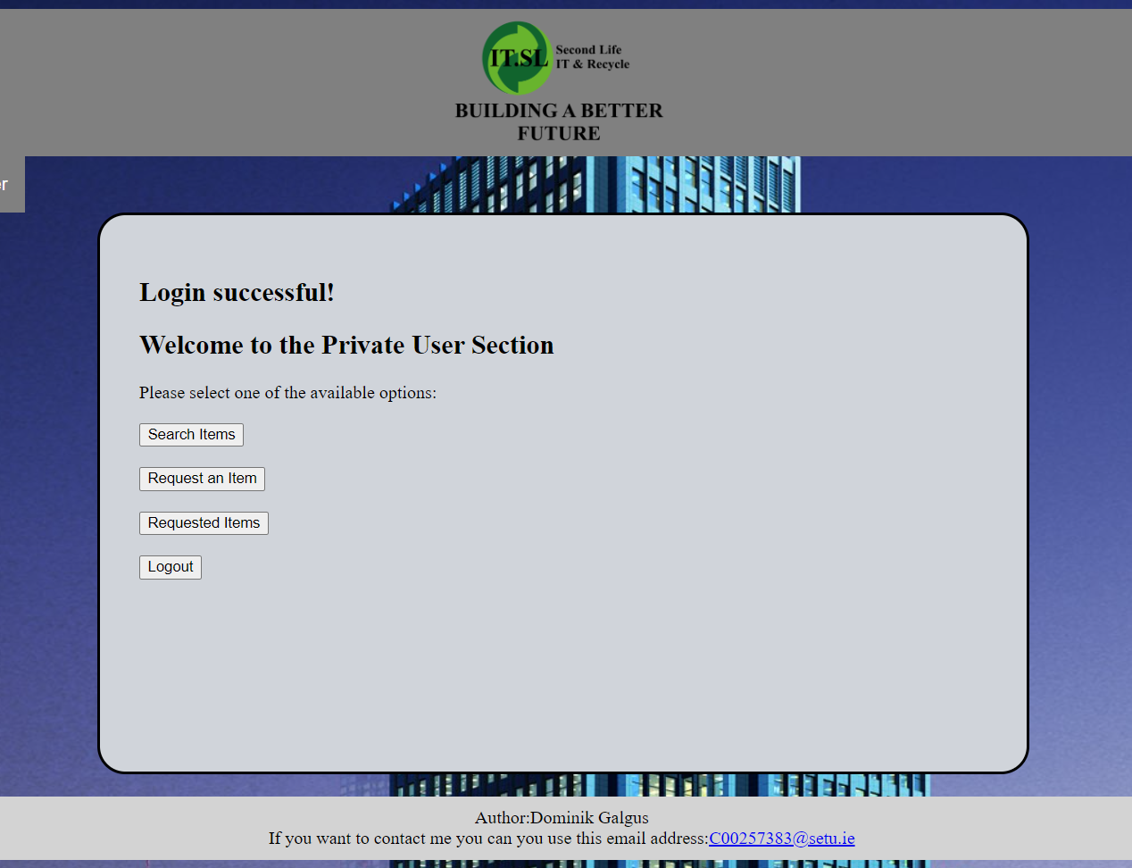
Login Screens
The Login Screens for the two users are similar.
But once they log in they are presented with different options
Attempt Number tracking System + Lock Out If too many attempts are attempted

Slide 19
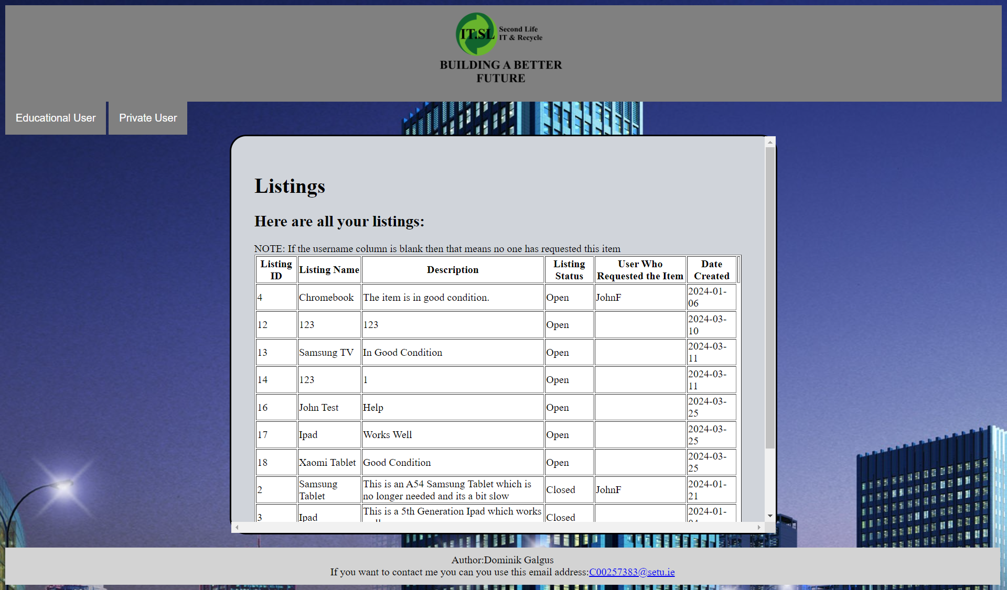
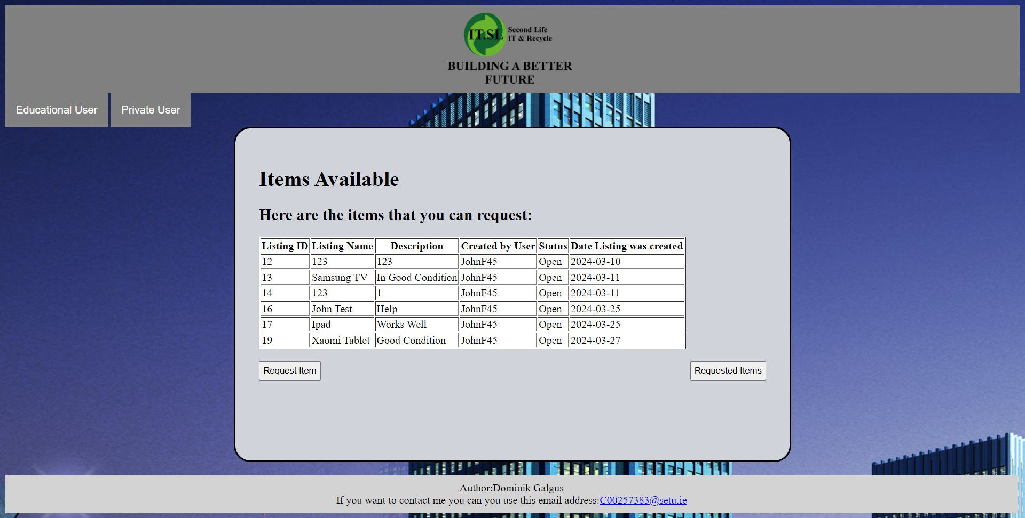
Search Items/Items Available
Educational User:
Search Items Screen Searches the listings made by user and provides information
Private User:
Items Available Screen searches available Items on the website which have not been claimed by anyone

Slide 20
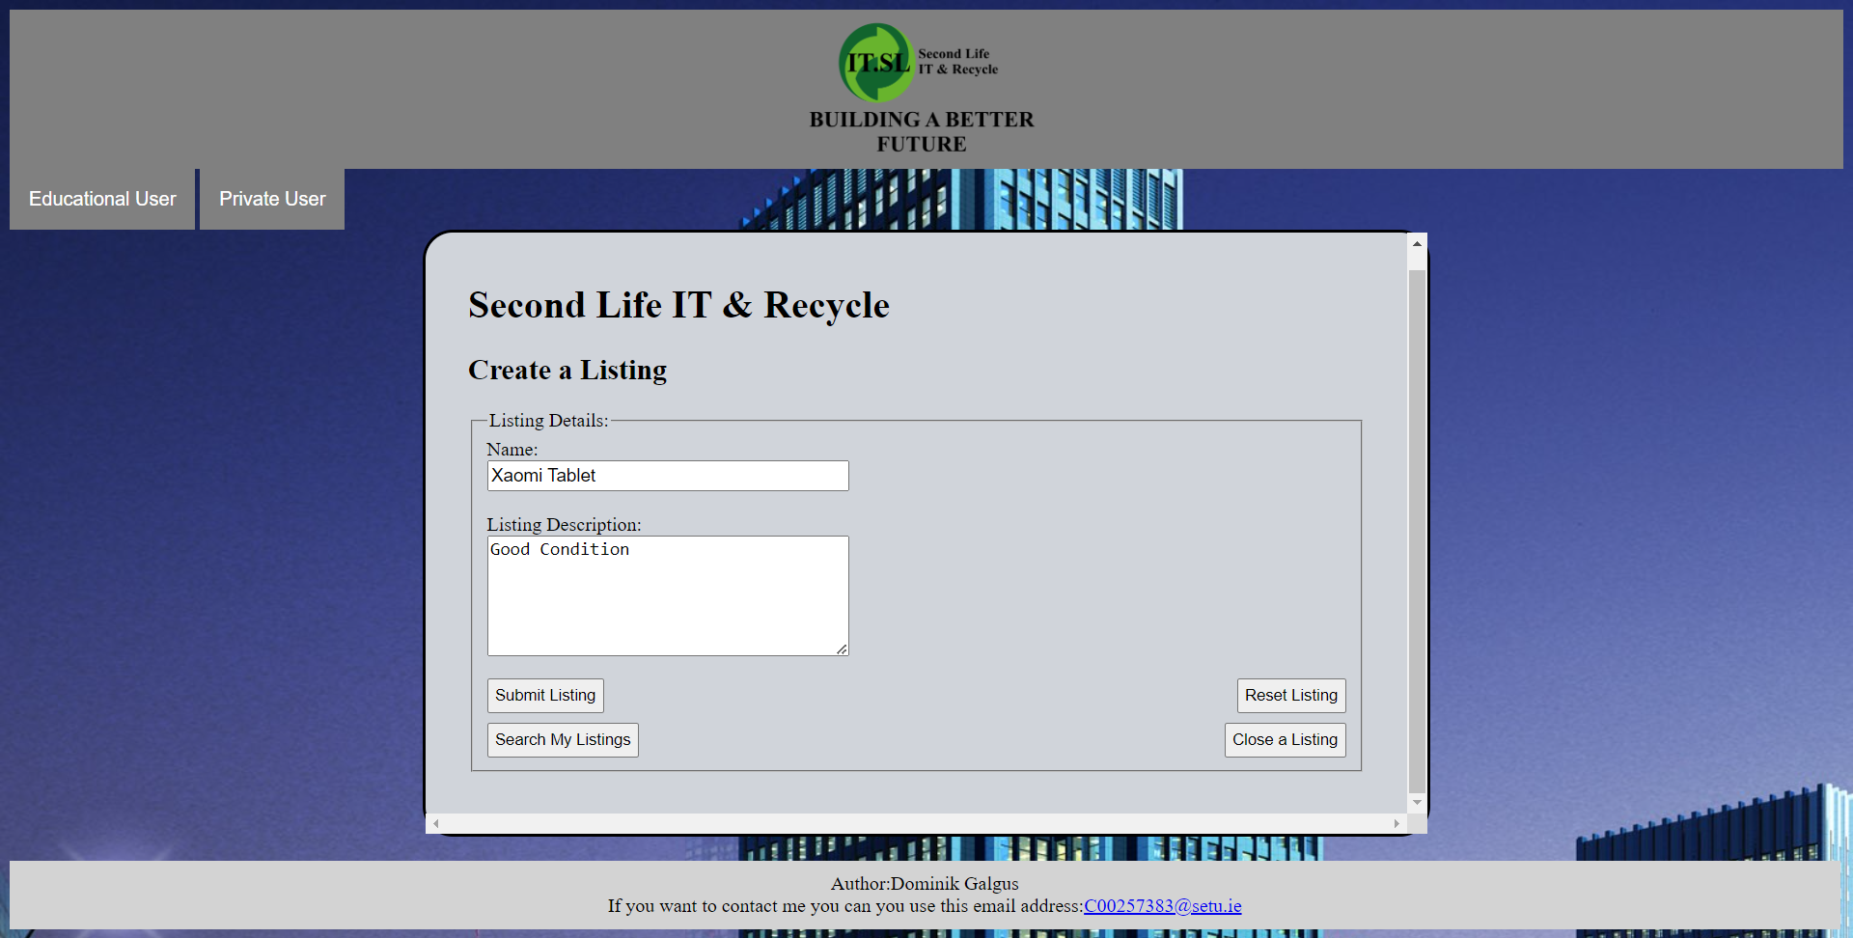
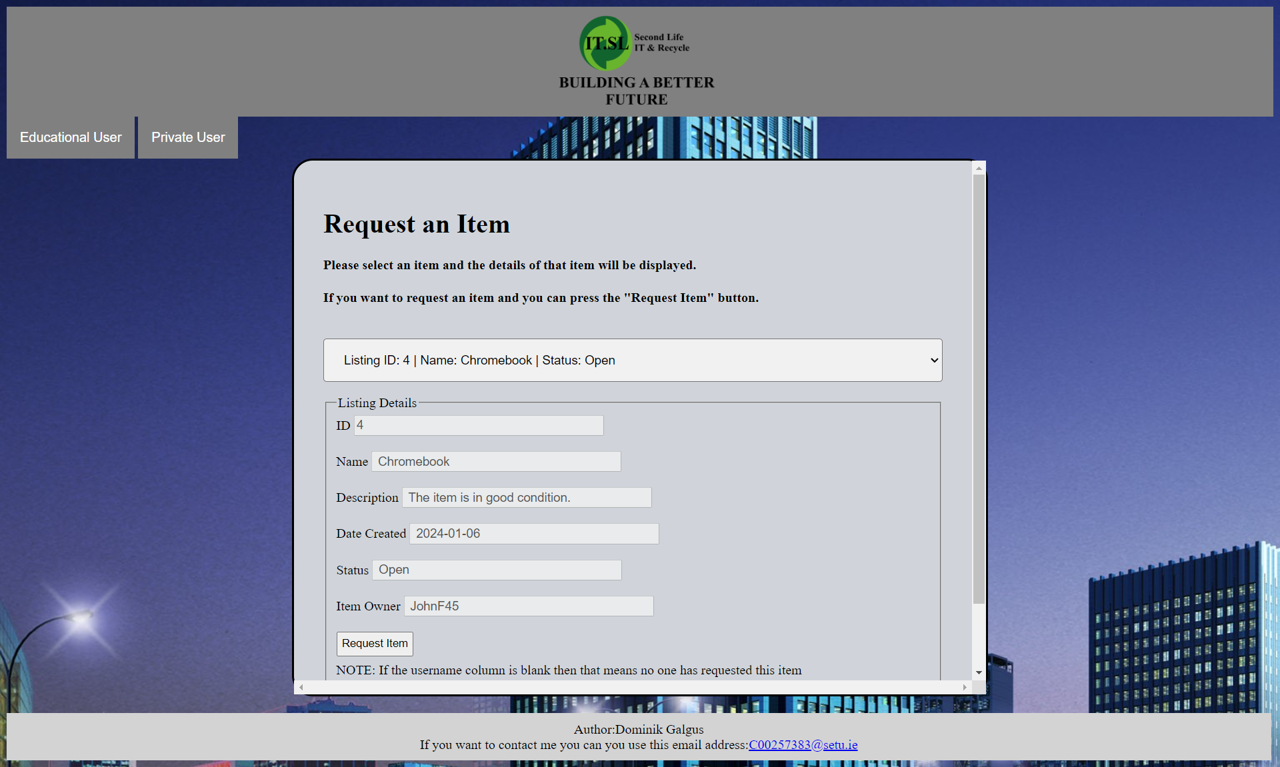
Create A Listing/ Request Item
Educational User:
Create A Listing : Allows the user to create a listing = will be put into the database
Private User:
Request Item: This allows the private user to “claim” or request an item on the website.

Slide 21
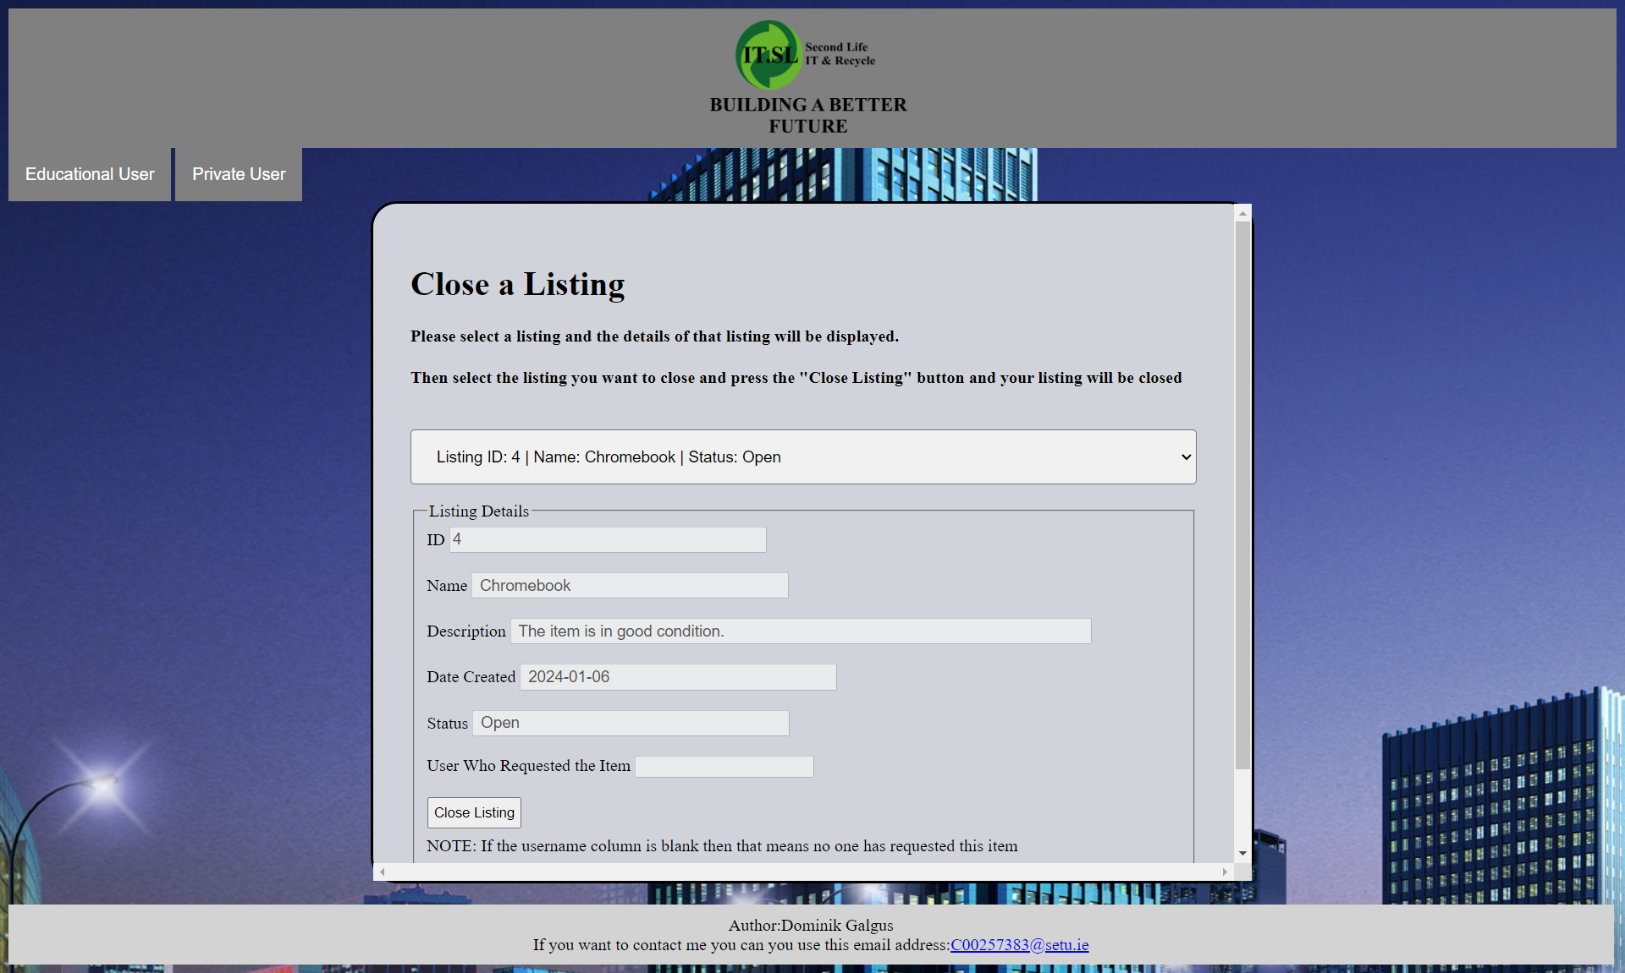
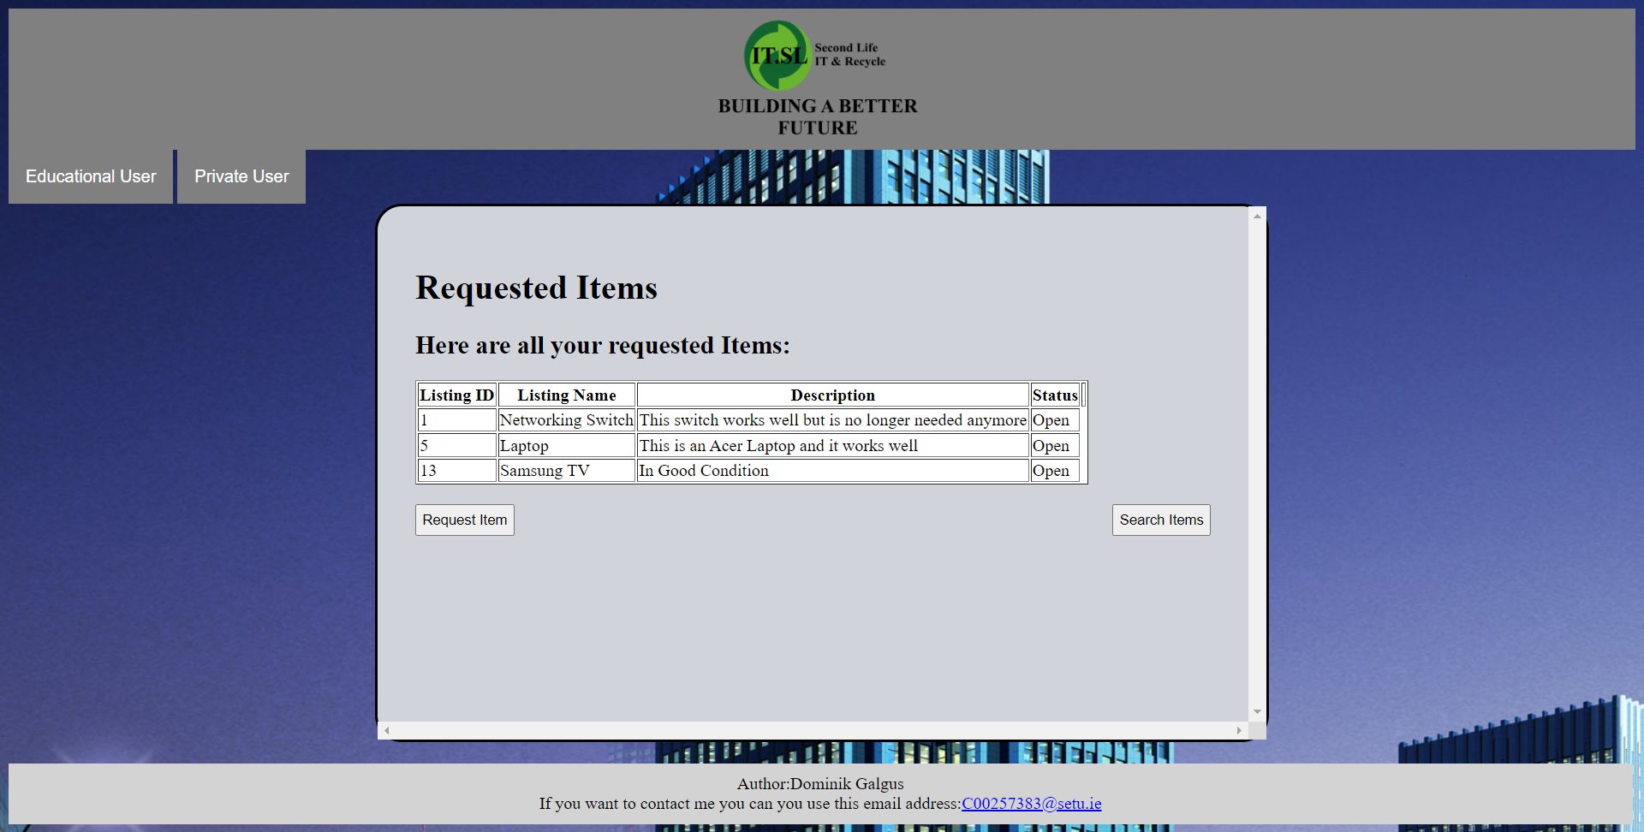
Close Listing/Requested Items
Educational User:
Close Listing Screen: This screen allows the educational to close of their listings
Private User:
Requested Items Screen: Allows the user to look at items that they have requested

Slide 22
LogOUT Screen
These screens allows the Educational User and Private User to log out of their accounts

Slide 23
Ethical Impact
1.Promoting Re-Use
This solution would help to promote re-use = Where technology is technology is not thrown away and instead used again
2.Promoting Proper Recycling
Can be used to promote proper recycling within society at large
Make sure that electronics are properly recycled instead of being thrown into the landfill.
Where they can do real harm to the environment and once they go into the landfill it also harder to get rid of them effectively

Slide 24
Reducing the Amount of Harmful Chemicals released into the Atmosphere
Proper recycling and re-use of IT equipment = reduces the amount of harmful chemicals being released into the atmosphere
As “70%” (TheWorldCounts,2023) of E-waste is Toxic and this toxic E-waste can harm the environment and cause problems.
As harmful chemicals can harm plants and pollute the ground =Making sure that nothing can grow in those areas.
Important

Slide 25
Conclusion
In this conclusion this presentation details all the work completed on the Second Life IT & Recycle Project.
The changes that would be made if this project was done again is that. Wordpress would be used to manage the overall structure of the website. To make it easier to develop the site.

Slide 26
References
TheWorldCounts (2023) Electronic Waste Facts [Online]
Available:
https://www.theworldcounts.com/challenges/planet-earth/waste/electronic-waste-facts
[Accessed 6th of the October 2023]
WordPress (2024) WordPress [Online]
Available:
https://wordpress.com/
Accessed 13t^{h} Of April 2024

Slide 27
References Continued
Data & IT Law (2024) THE OVERVIEW OF 15 GDPR COMPLIANCE OBLIGATIONS FOR A COMPANY PROCESSING PERSONAL DATA [Online]
Available:
https://www.dataitlaw.com/overview-15-gdpr-compliance-obligations/#:~:text=implement%20measures%20to%20ensure%20a,data%20as%20much%20as%20possible
Accessed 13th Of April 2024

